Slide 1
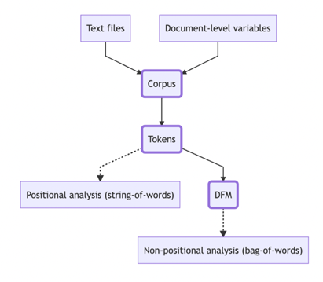
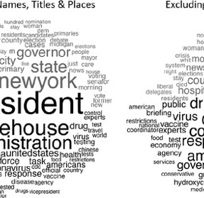
THE QUANTEDA PACKAGE IN R : Computational text analysis for news and social datasets
Dr. Trevor Diehl :: Central Michigan University :: Guest PhD Seminar :: 2/20/24
University of Alabama, Department of Journalism & Creative Media
Notes:
1

Slide 2

Today
Introduction
Computation Text Analysis Methods (CTAM)
Demo: Quanteda package in R
Fake news dataset
January 6th journalists on Twitter
Notes:
1

Slide 3
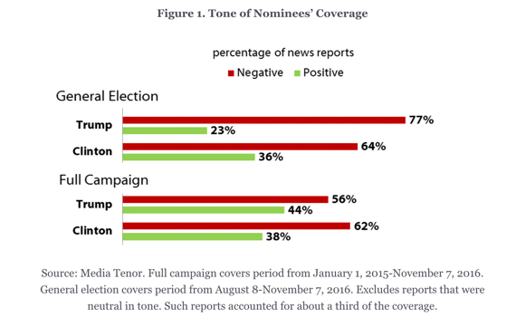
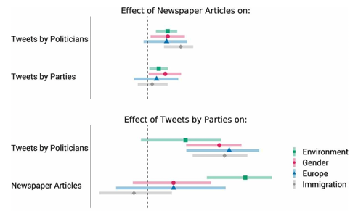
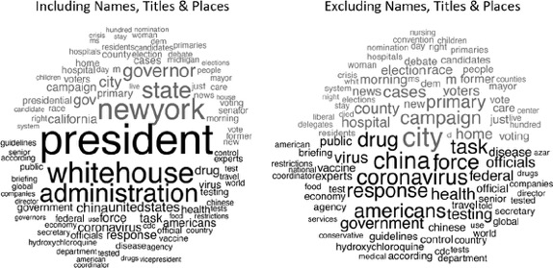
What is Computational Text Analysis?
Notes:
1
1) https://shorensteincenter.org/news-coverage-2016-general-election/
2) Gilardi, Fabrizio, Theresa Gessler, Mael Kubli, and Stefan Muller. “Social Media and Political Agenda Setting.” Political Communication 39, no. 1 (2 January 2022): 39–60
3) Hart, P. S., Chinn, S., & Soroka, S. (2020). Politicization and Polarization in COVID-19 News Coverage. Science Communication, 42(5), 679–697. https://doi.org/10.1177/1075547020950735
Figure 4. Words distinguishing Republicans and Democrats in COVID-19 coverage. (A) Including names, titles, and places; (B) Excluding names, titles, and places.
Note. Black words in the bottom half of the comparison clouds are those most closely associated with Republicans and grey words in the top half are most closely associated with Democrats. The size of the words indicates both the frequency of use and distinctiveness of the word with the affiliated party.

Slide 4
Learning Outcomes
Basic understanding of Computation Text Analysis Methods (CTAM)
Get some practical advice for social scientific researchers
Ability to apply an analysis workflow in R
Word clouds
Summary statistics and visualizations
Sentiment analysis (dictionaries)
Notes:
1

Slide 5
What is Computational Text Analysis?
Notes:
1
Formal definition from Birkenmaier
Computational text analysis methods (CTAM) analyze written or spoken language, where ‘text as data’ is used as a source in research. Whereas the term CTAM encompasses diverse methods and applications, it commonly entails the use of algorithms and automated software tools to analyze texts, varying in the extent of human supervision required (Grimmer & Stewart, 2013). In communication research, CTAM are usually applied to study and operationalize social science constructs, namely, abstract and theoretical concepts which are not directly observable, such as emotions, audience frames, or ideology (Krippendorff, 2018).
Birkenmaier, L., Lechner, C. M., & Wagner, C. (2023). The Search for Solid Ground in Text as Data: A Systematic Review of Validation Practices and Practical Recommendations for Validation. Communication Methods and Measures, 0(0), 1–29. https://doi.org/10.1080/19312458.2023.2285765

Slide 6
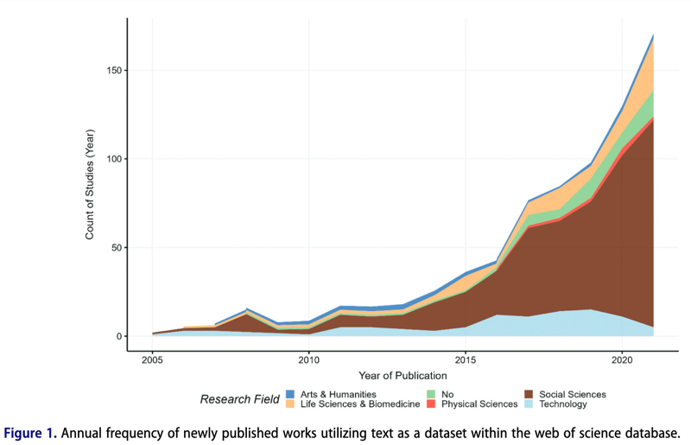
Prominence
Birkenmaier et al., (2023)
Notes:
1
Birkenmaier, L., Lechner, C. M., & Wagner, C. (2023). The Search for Solid Ground in Text as Data: A Systematic Review of Validation Practices and Practical Recommendations for Validation. Communication Methods and Measures, 0(0), 1–29. https://doi.org/10.1080/19312458.2023.2285765

Slide 7




Types of Text Analysis
Filter
Digital
Sources
Dictionaries
Supervised
Unsupervised
Notes:
1

Slide 8
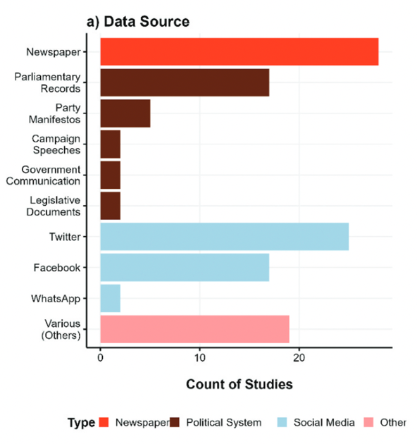
News & Social Data Sources
Birkenmaier et al., (2023) *Based on 100 studies published in communication/political science
Notes:
1
Birkenmaier, L., Lechner, C. M., & Wagner, C. (2023). The Search for Solid Ground in Text as Data: A Systematic Review of Validation Practices and Practical Recommendations for Validation. Communication Methods and Measures, 0(0), 1–29. https://doi.org/10.1080/19312458.2023.2285765

Slide 9
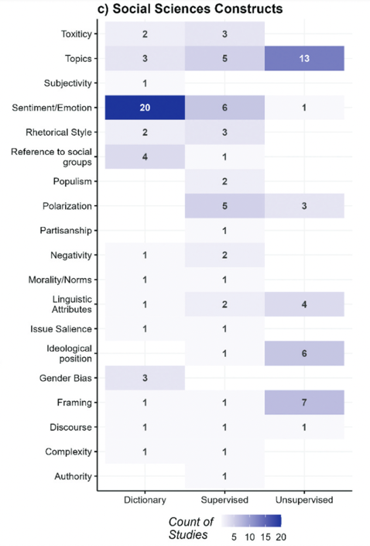
Social Scientific Constructs
Birkenmaier et al., (2023)
Notes:
1
Birkenmaier, L., Lechner, C. M., & Wagner, C. (2023). The Search for Solid Ground in Text as Data: A Systematic Review of Validation Practices and Practical Recommendations for Validation. Communication Methods and Measures, 0(0), 1–29. https://doi.org/10.1080/19312458.2023.2285765

Slide 10
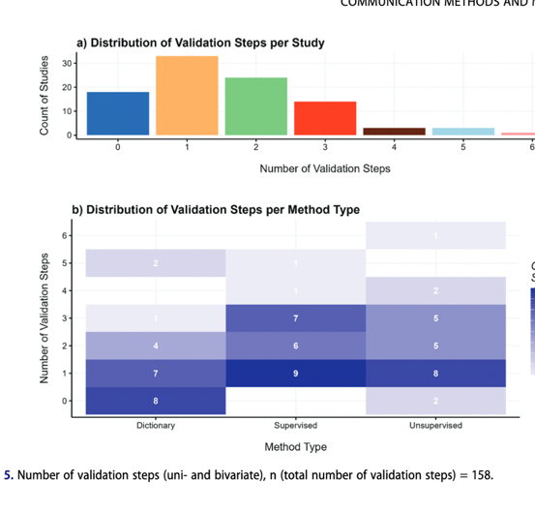
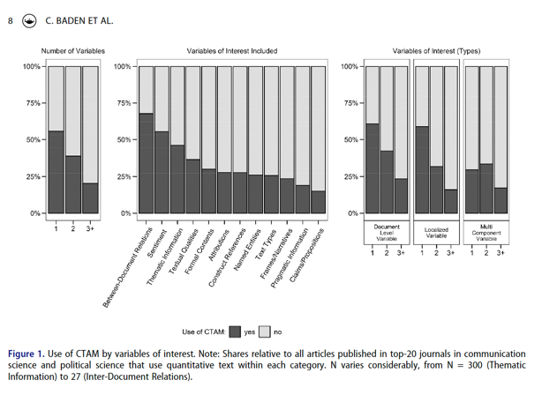
Gaps & Limitations
Reliability and validity
Reliance on single-construct
English and comparative
Birkenmaier et al., (2023)
Notes:
1
Baden, C., Pipal, C., Schoonvelde, M., & van der Velden, M. A. C. G. (2022). Three Gaps in Computational Text Analysis Methods for Social Sciences: A Research Agenda. Communication Methods and Measures, 16(1), 1–18. https://doi.org/10.1080/19312458.2021.2015574 *854 articles across social sciences
Birkenmaier, L., Lechner, C. M., & Wagner, C. (2023). The Search for Solid Ground in Text as Data: A Systematic Review of Validation Practices and Practical Recommendations for Validation. Communication Methods and Measures, 0(0), 1–29. https://doi.org/10.1080/19312458.2023.2285765 * 96 studies in pol comm

Slide 11
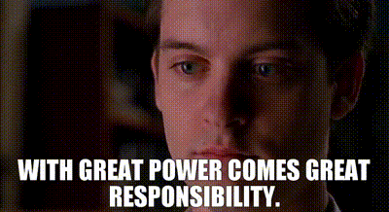
Practical Considerations
Considerations for Research Design
Deductive v. Iterative Models
Discovery — Measurement — Inference
The “Gold Standard” ideal
Notes:
1

Slide 12
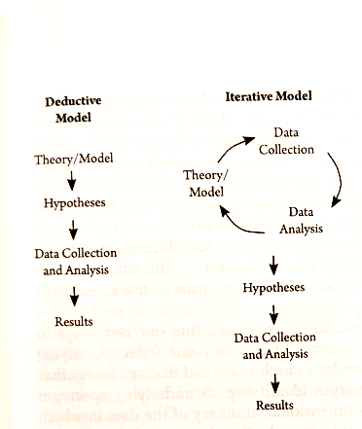
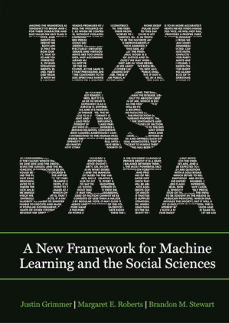
Deductive & Iterative Models
Notes:
1
Grimmer, J., Roberts, M. E., & Stewart, B. M. (2022). Text as data: A new framework for machine learning and the social sciences. Princeton University Press.

Slide 13
Discovery—Measurement—Inference
Discovery
Conceptualization
Reduce complexity
Organize text
Measurement
Clear goals
Explainable
Reproducible
Validity checks
Inference
Causal
Predictive
Notes:
1
Causal RQ: How does sentiment in social media news effect engagement?
Predictive RQ: Negative fake news stories toward the opposition candidate will receive more engagement.

Slide 14
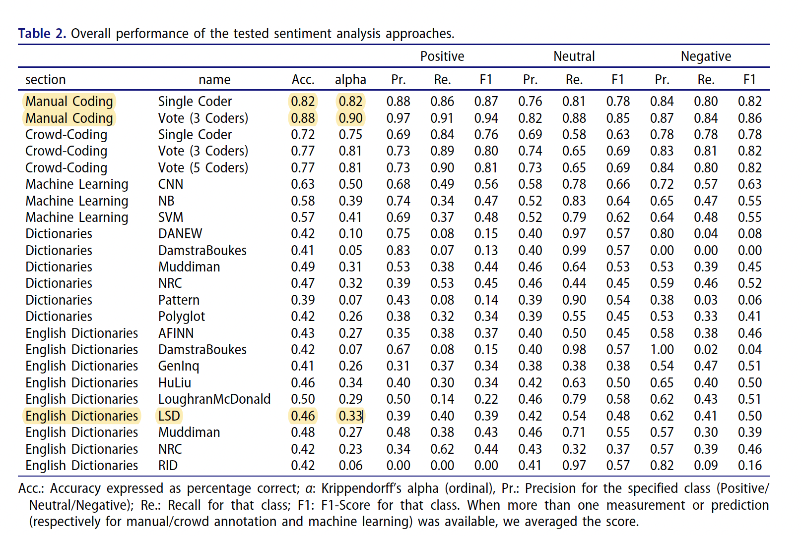
Gold Standard Ideal
Notes:
1
van Atteveldt, W., van der Velden, M. A. C. G., & Boukes, M. (2021). The Validity of Sentiment Analysis: Comparing Manual Annotation, Crowd-Coding, Dictionary Approaches, and Machine Learning Algorithms. Communication Methods and Measures, 15(2), 121–140. https://doi.org/10.1080/19312458.2020.1869198
https://en.wikipedia.org/wiki/Precision_and_recall

Slide 15
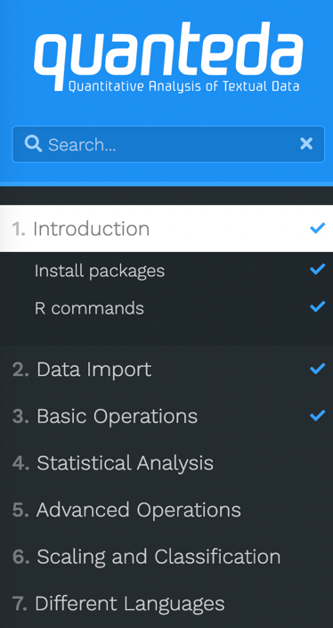
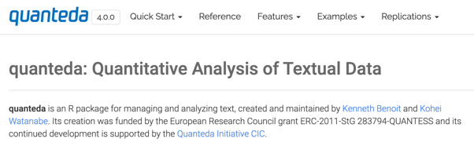
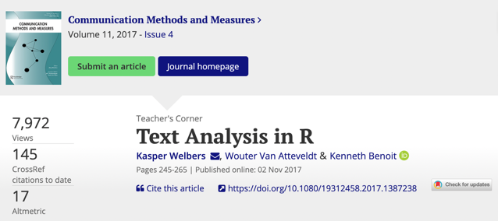
Demonstration in R
Notes:
1
1) https://tutorials.quanteda.io/
2) https://quanteda.io/index.html
3) Welbers, K., Atteveldt, W. V., & Benoit, K. (2017). Text Analysis in R. Communication Methods and Measures, 11(4), 245–265. https://doi.org/10.1080/19312458.2017.1387238

Slide 16
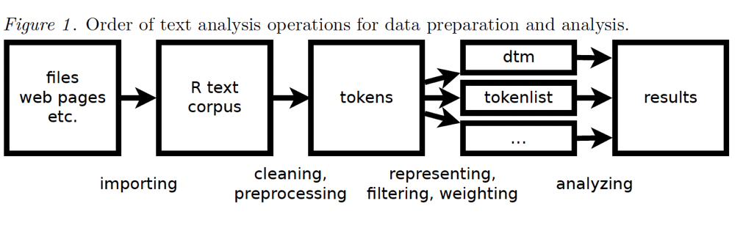
Welbers, K., Atteveldt, W. V., & Benoit, K. (2017). Text Analysis in R. Communication Methods and Measures, 11(4), 245–265.
Notes:
1
Welbers, K., Atteveldt, W. V., & Benoit, K. (2017). Text Analysis in R. Communication Methods and Measures, 11(4), 245–265. https://doi.org/10.1080/19312458.2017.1387238

Slide 17
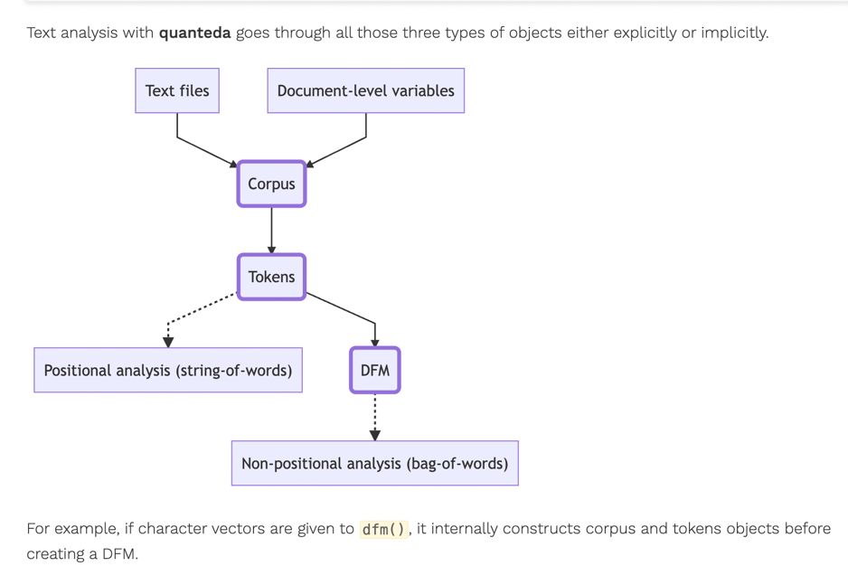
Notes:
1
https://tutorials.quanteda.io/basic-operations/workflow/

Slide 18
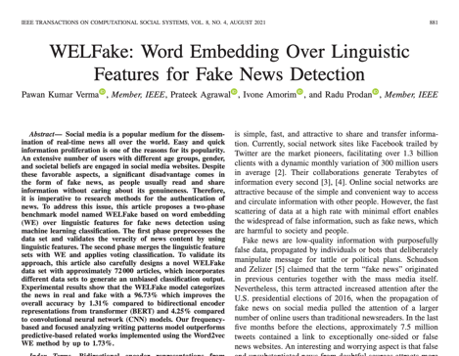
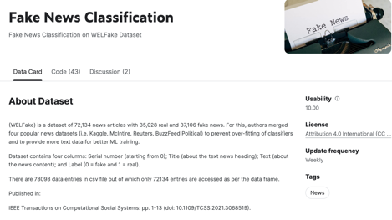
Random Political News Dataset for Machine Learning
N = 75 posts from Fake, Real, and Satirical online webpages
N = 225
Verma, P. K., Agrawal, P., Amorim, I., & Prodan, R. (2021). WELFake: word embedding over linguistic features for fake news detection. IEEE Transactions on Computational Social Systems, 8(4), 881-893.
Notes:
1
https://www.kaggle.com/datasets/saurabhshahane/fake-news-classification
https://ieeexplore.ieee.org/document/9395133
Random Political News Data:
Randomly collected from three types of sources during 2016.
Sources ground truth determined through: Business Insider’s Most Trusted list
2016 Fake news list
Sources:
- Real: Wall Street Journal, The Economist, BBC, NPR, ABC, CBS, USA Today, The Guardian, NBC, The Washington Post
- Satire: The Onion, Huffington Post Satire, Borowitz Report, The Beaverton, Satire Wire, and Faking News
- Fake: Ending The Fed, True Pundit, abcnews.com.co, DC Gazette, Liberty Writers News, Before its News, InfoWars, Real News Right Now

Slide 19

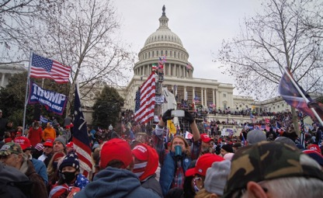
Journalists on Twitter: January 6th Dataset
Journalist and other news actors on Twitter day of January 6th 2021
Curated list of 198 news actors and top 5,000 posts + engagement statistics pulled from Twitter firehose API via Brandwatch
Notes:
1

